Slide 1
Phonemic Transcription of English
Nonsense and no-nonsense words!

Slide 2


Transcribe the following words phonemically
Create a possible spelling for the nonsense words. Spell the real words and guess the accent.*
1-13 are nonsense words. 14-22 are real words realised in different accents.
Your phonemic inventory should reflect the distribution of sounds in each accent.
1 | 2 | 3 | 4 | 5 | 6
7 | 8 | 9 | 10 | 11 | 12
13 | 14 | 15 | 16 | 17 | 18
19 | 20 | 21 | 22
Created by Antoin Rodgers under Creative Commons Attribution-ShareAlike 4.0 License - rodgeran@tcd.ie - @phonetic_antoin
*Bear in mind these, are my imitations of each accent. Suggested answers on the next slide.

Slide 3
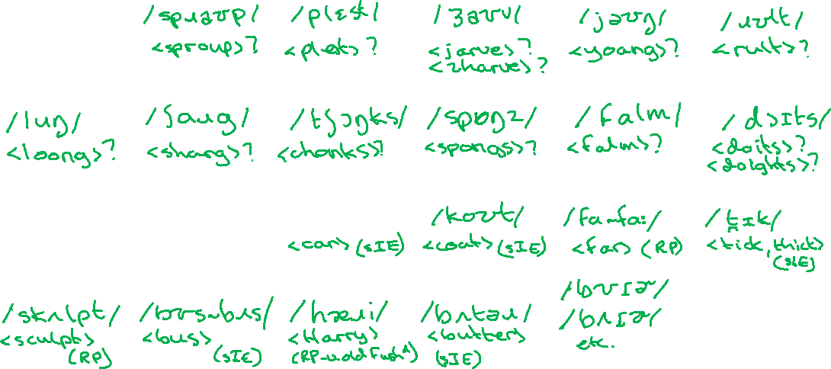

Transcribe the following words phonemically
Create a possible spelling for the nonsense words. Spell the real words and guess the accent.*
1-13 are nonsense words. 14-22 are real words realised in different accents.
Your phonemic inventory should reflect the distribution of sounds in each accent.
1 | 2 | 3 | 4 | 5 | 6
7 | 8 | 9 | 10 | 11 | 12
13 | 14 | 15 | 16 | 17 | 18
19 | 20 | 21 | 22
Created by Antoin Rodgers under Creative Commons Attribution-ShareAlike 4.0 License - rodgeran@tcd.ie - @phonetic_antoin
nIE
*Bear in mind these, are my imitations of each accent.

